Slide 1

Housing Prices & Venues Data Analysis of London

Slide 2
London Boroughs:
London is one of the largest metropolises in the world where over 9.3 million people live and it has a population density of 5,701 people per square kilometer. I’ve decided to use London in my project. The city is divided into local authority districts that make up the ceremonial county of Greater London; each is governed by a London borough council.

Slide 3
From its status as a global capital market to a leading centre for history, culture and education, London’s appeal shows little sign of abating. A web of 33 thriving boroughs, the capital is an incongruous mix of old and new, a city where the cutting-edge and uber-cool innovation hubs stand effortlessly alongside historic and iconic landmarks.
Investment across the breadth of the City continues apace, its hotspots continuously reinvented and once-forgotten corners regenerated. Well-connected within London, the UK and beyond, the capital is always accessible, and the impending Elizabeth Line will tighten links between east to west even further. Visitors can take their pick from four world heritage sites, and with a host of parks, museums and galleries, even the locals will struggle to get bored.

Slide 4
Property Prices in London
London is a city with a high population and population density. Being such a crowded city leads the owners of shops and social sharing places in the city where the population is dense. When we think of it by the investor, we expect from them to prefer the districts where there is a lower real estate cost and the type of business they want to install is less intense.
If we think of the city residents, they may want to choose the regions where real estate values are lower, too. At the same time, they may want to choose the district according to the social places density. However, it is difficult to obtain information that will guide investors in this direction, nowadays.
When we consider all these problems, we can a bar graph where the real estate index is placed on London and each borough is clustered according to the venue density

Slide 5
Problem in Hand
The residents across the breadth of the boroughs cited infrastructure, amenities, schools and venues are key attributes that drew them to an area. But the over-riding factor for many is the people within their reach, who, it’s widely accepted help make their locality a community, and their property a home.
This project will contribute in determining the qualitative aspects of a locality/borough like the various schools, offices and restaurants available at a nearby distance which can help a potential resident make a decision based on his needs and requirements and priorities. This project will also help a buyer/renter analyse the property price trend across the 33 boroughs in London for them to decide on the affordable borough.

Slide 6
Data acquisition and cleaning
Data sources:
1.Borough Data - by Kaggle
This dataset contains the latitude and longitude data along with population and distance from center data for Boroughs. We will be using the latitude and longitude data for Boroughs in London.
2.Borough Code Mapping Data - by Kaggle
This dataset contains the Postal/zip code mapping to Boroughs of London. We will be using this data to map the boroughs to the code data.
3.Borough Price Data - by Kaggle
This dataset contains the price data for housing sales for past fe years in London boroughs. We will be using the data for last 3 years only.

Slide 7
Data Cleaning
Data downloaded or scraped from multiple sources were combined into one table. There was a lot of missing values which were eventually removed from the final dataset as they did not add any value to the analysis. The data was also filtered to analyse the data for past 3 years only. Any duplicate entries were removed.

Slide 8
Methodology
As a database, I used GitHub repository in my study. My master data which has the main components Borough, Average House Price, Latitude and Longitude and postal code informations of the city.
I used Forsquare API to get the most common venues of given Borough of London
I used python folium library to visualize geographic details of London and its boroughs and I created a map of London with boroughs superimposed on top. I used latitude and longitude values to get the visual.

Slide 9
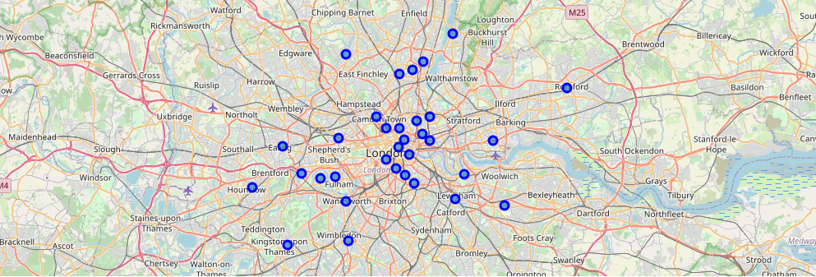
Map of London with boroughs superimposed on top

Slide 10
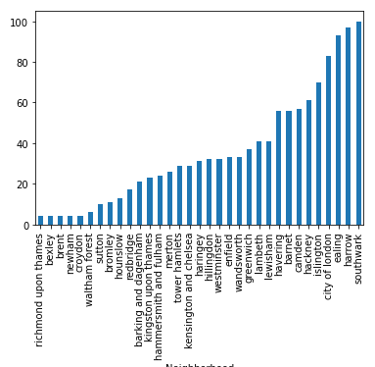
Number of venues in each Borough

Slide 11
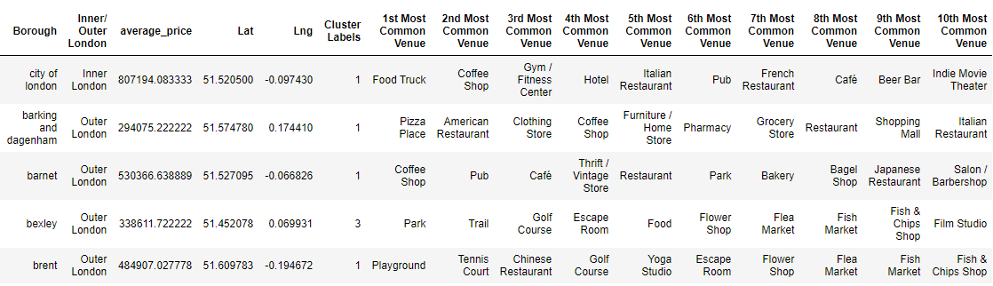
Using K-means to form clusters:
We have some common venue categories in boroughs. In this reason I used unsupervised learning K-means algorithm to cluster the boroughs. K-Means algorithm is one of the most common cluster method of unsupervised learning.
I will run K-Means to cluster the boroughs into 5.

Slide 12
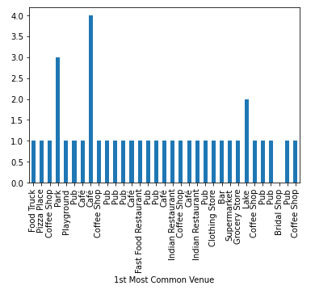
We can also estimate the number of 1st Most Common Venue in each cluster. Thus, we can create a bar chart which may help us to find proper labels for each cluster.

Slide 13
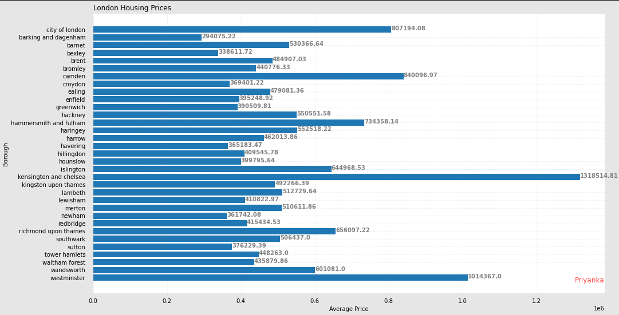
Analysis of frequency of average housing sales prices in different ranges. Thus, histogram can help to visualization:

Slide 14
We can analyse Boroughs in London in three categories:
On the basis of our budget one can easily choose among the Price-category of the Boroughs.
And on the basis of venue analysis we can come to a conclusion as to what category will benefit us the most in respective borough.
1. High Class Boroughs (~ 750,000+):
-Kensington and Chelsea
-Westminster
-Camden
2. Mid-Class Boroughs (300,000 – 750,000):
-Barnet
-Islington
-Wands worth
3. Lower Class Boroughs (200,000 – 300,000):
-Barking and Dagenham
-Bexley
-Havering

Slide 15
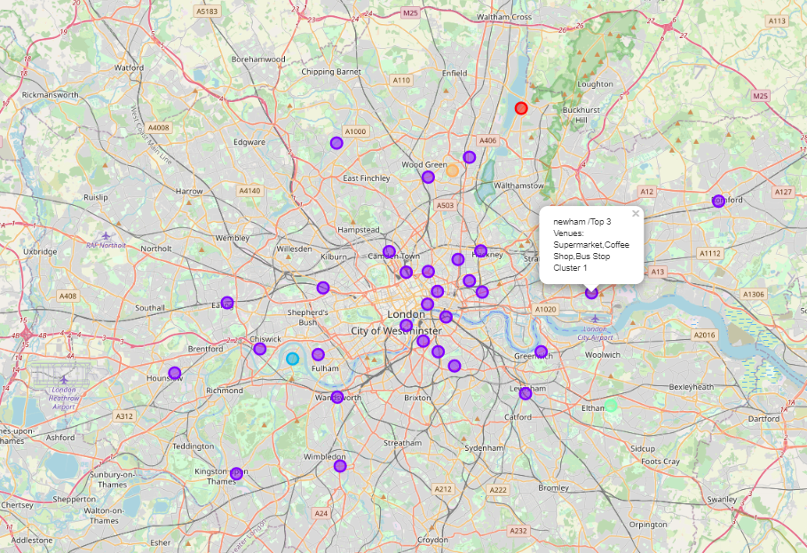
Clustered map boroughs of London

Slide 16
Discussion
London is one of the largest metropolises in the world where over 9.3 million people live and it has a population density of 5,701 people per square kilometer. I’ve decided to use London in my project. The city is divided into local authority districts that make up the ceremonial county of Greater London; each is governed by a London borough council.
I used the Kmeans algorithm as part of this clustering study. I set the optimum k value to 5. For more detailed and accurate guidance, the data set can be expanded and the details of the neighborhood or street can also be drilled.
I also performed data analysis through this information by adding the coordinates of districts and home sales price averages as static data on GitHub. In future studies, these data can also be accessed dynamically from specific platforms or packages.
I ended the study by visualizing the data and clustering information on the London map. In future studies, web or telephone applications can be carried out to direct investors.

Slide 17
Conclusion
As a result, people are turning to big cities to start a business or work. For this reason, people can achieve better outcomes through their access to the platforms where such information is provided.
Not only for investors but also city managers can manage the city more regularly by using similar data analysis types or platforms.

Slide 18
References
[1] London — Wikipedia
[2] London Boroughs House Price, Crime and Population data — Kaggle
[3] Foursquare API
[4] Google Map

Slide 19
Thank You !

